Slide 1


P
raedico
A custom recommender engine for The Book Empire

Slide 2

E
very once in a while, a
new technology, an
old problem, and a
big idea turn into an
innovation.

Slide 3
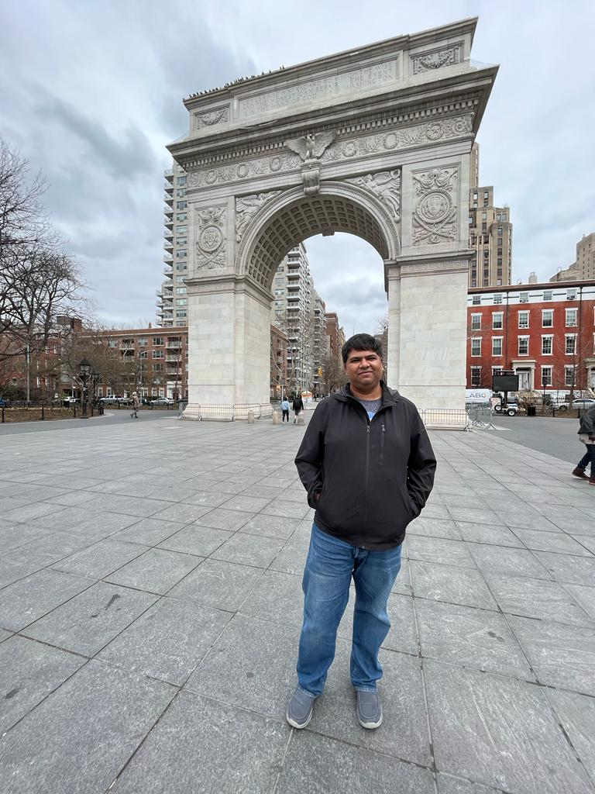
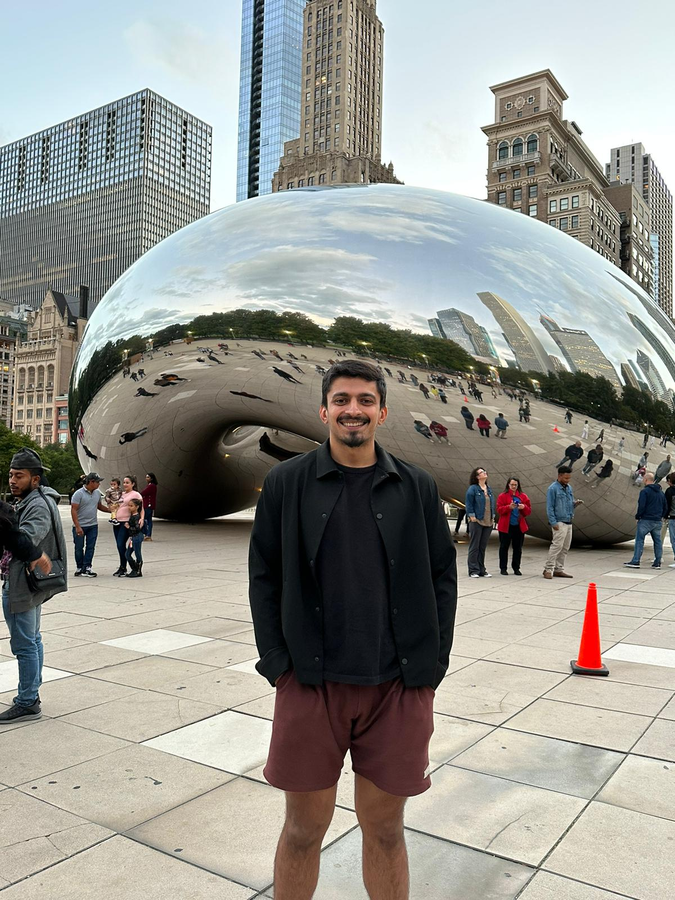


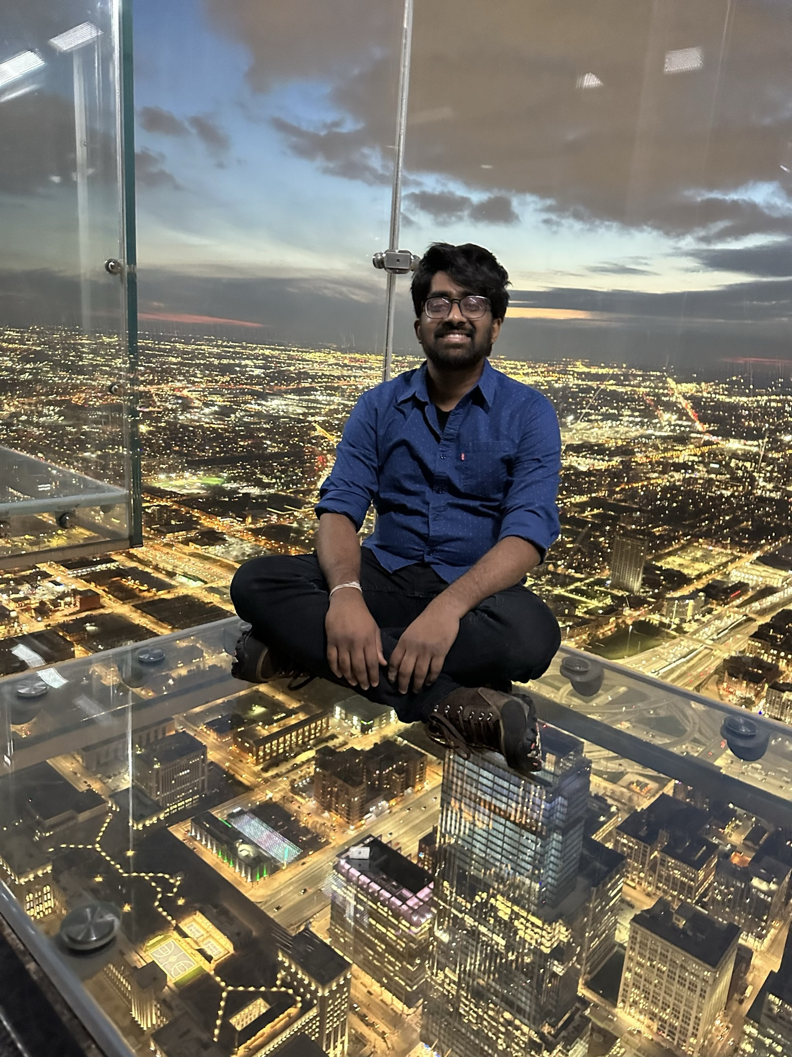

Siddharth
Puranam
US
Sr. Financial Analyst
Abhishek P
Sr. Data Scientist
Jose A Gerala
Vivian Yeh
Chief of Sales
Marketing Manager
Vishal P
Swathi Ganesan
Creative Director
Marketing Manager

Slide 4
-01-
Introduction
-02-
EDA
-03-
Glimpses
Praedico
-04-
Segments
-05-
Strategy
Contents
-06-
Economics
-07-
Timeline
-08-
Improvements

Slide 5


Introduction
Logo Design
DYNAMIC
RECOMMENDATIONS
STATIC
RECOMMENDATIONS

Slide 6
9.4 M
8.5M

Slide 7

EXPLORATORY
DATA
ANALYSIS

Slide 8
HISTOGRAMS

Slide 9
CATEGORY
MONETARY

Slide 10

A
GLIMPSE

Slide 11

STATIC
RECOMMENDER

Slide 12
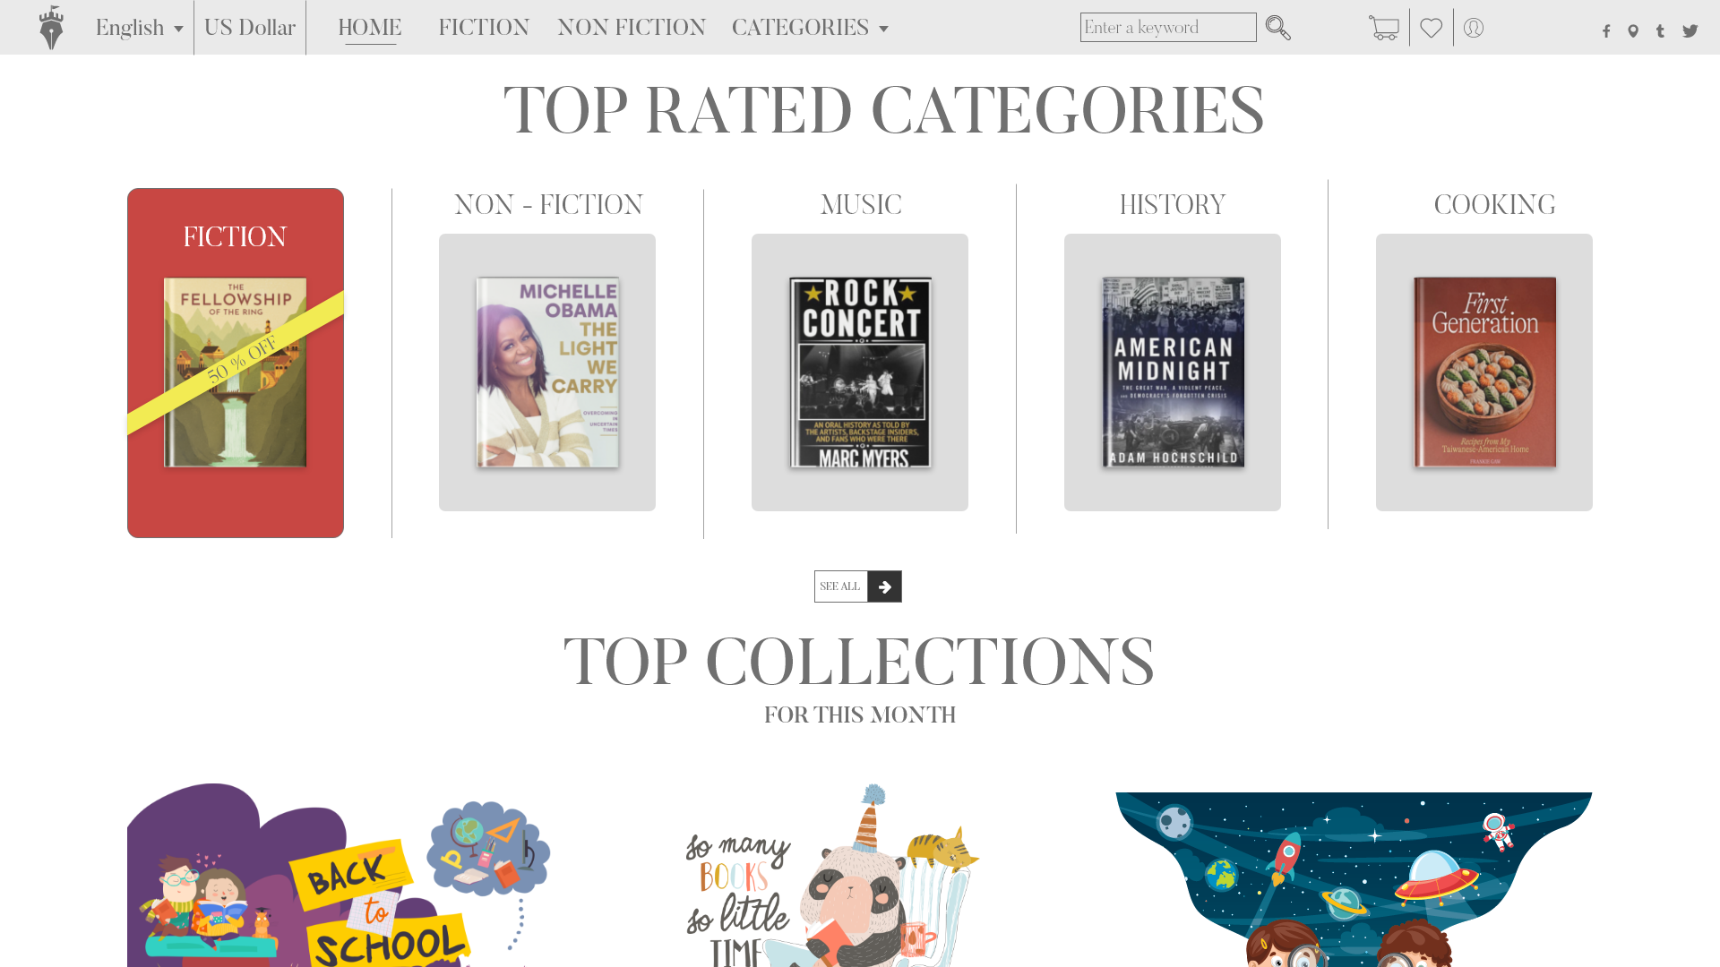
STATIC
RECOMMENDER
DYNAMIC
RECOMMENDER

Slide 13
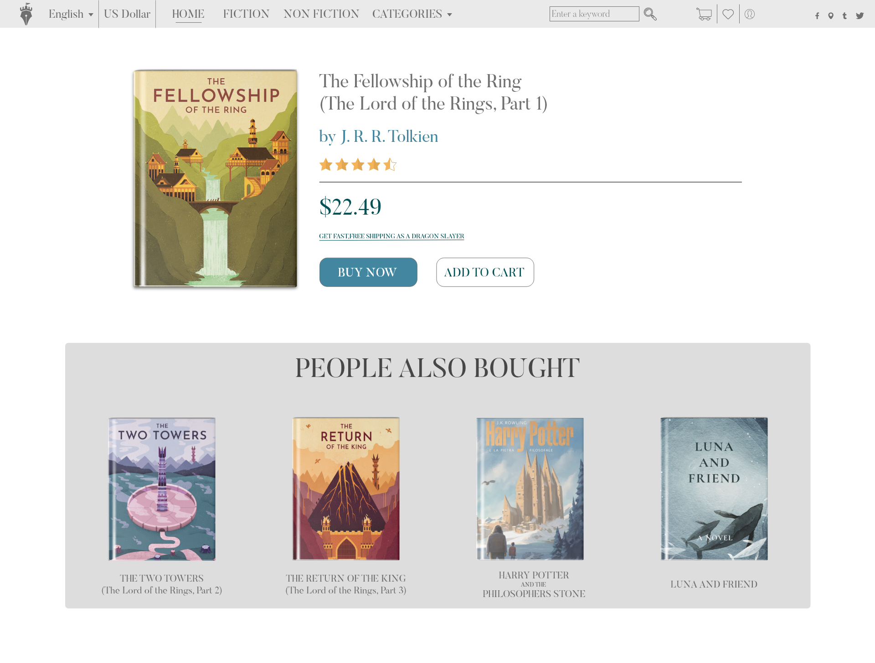
DYNAMIC
RECOMMENDER

Slide 14
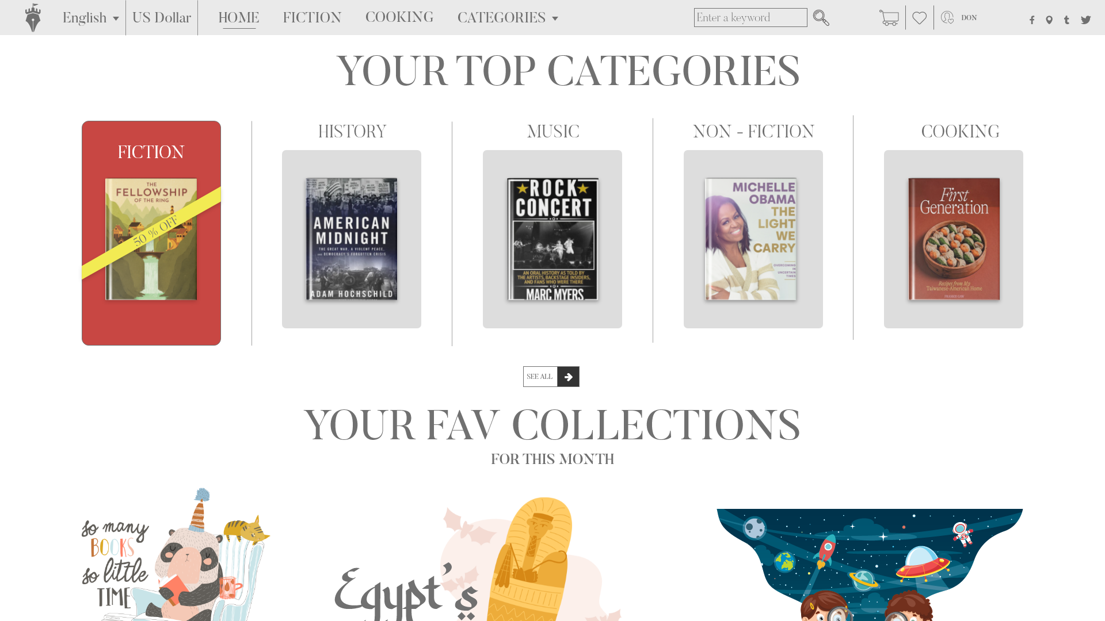
DYNAMIC
RECOMMENDER

Slide 15
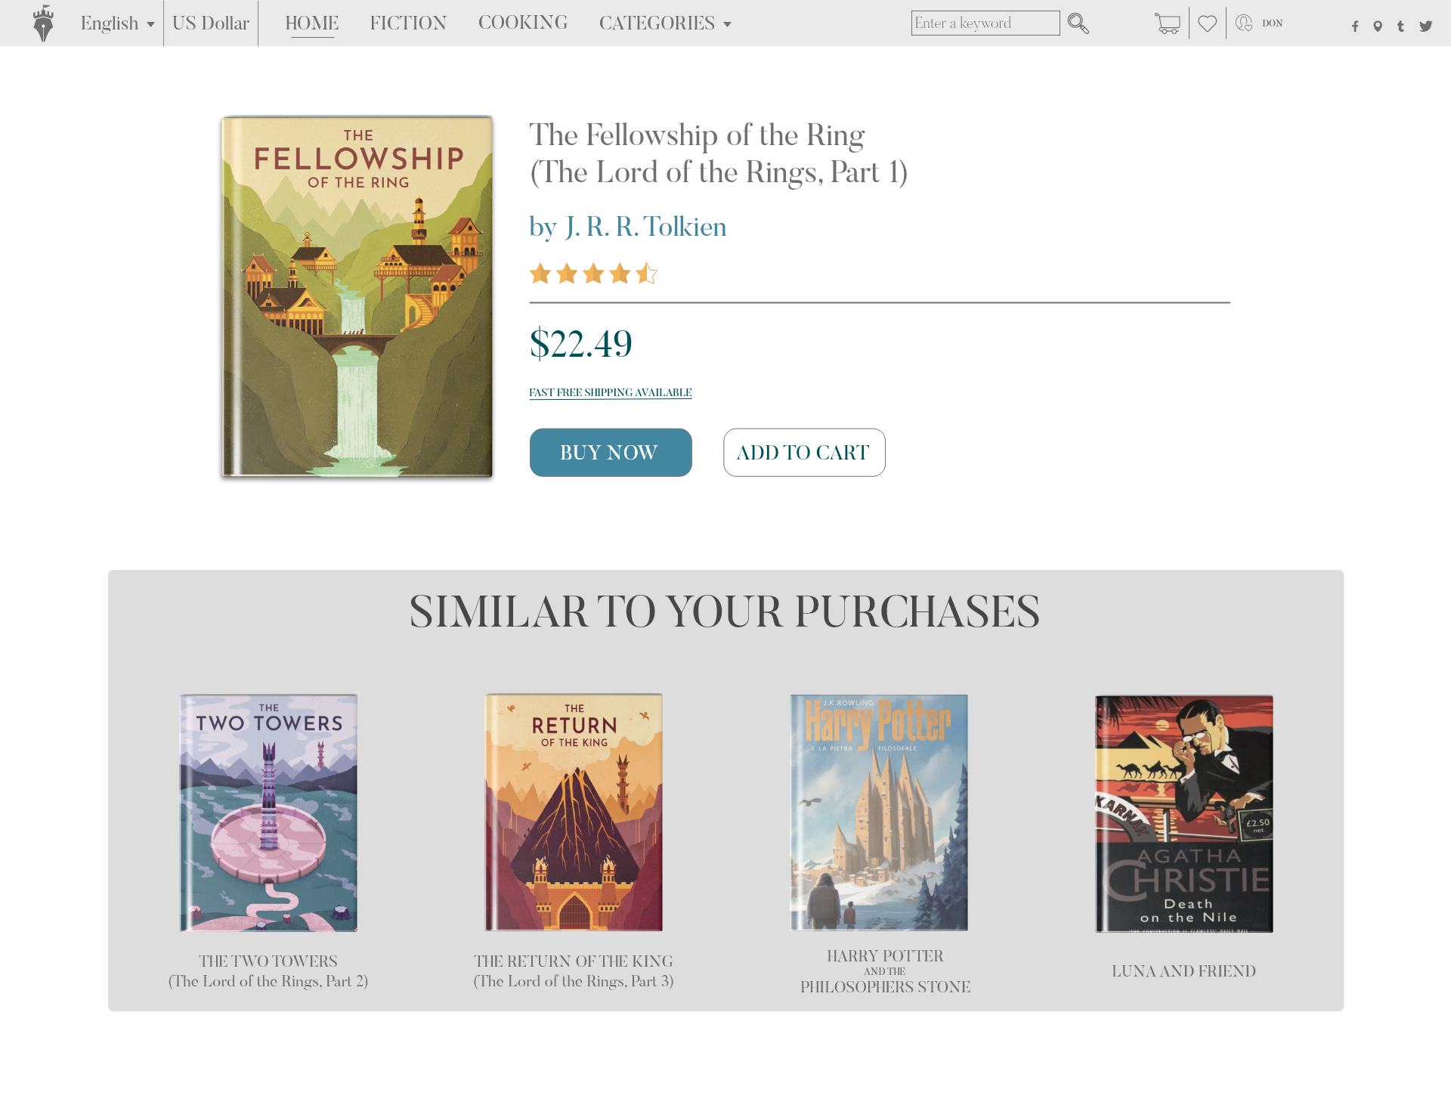
DYNAMIC
RECOMMENDER

Slide 16
SEGMENTS

Slide 17
SCORE = R*.14 + F*.28 + M*.57

Slide 18
DRAGON SLAYERS
15%
KNIGHTS
SEGMENTS
50%
SQUIRES
85%
LAGGERS
100%

Slide 19
STRATEGY

Slide 20

Loyalty Program
1
Dragon Slayers get free entry
Access to presales
Author Insights
Book Signings queue skip
STRATEGIES
Promotions
2
Standard offers for Paperbacks and Muggles
Paid Access to Loyalty Program
3
Activations
Emails regarding top upcoming books
Notes:
Based on the segments that we get from our RFM segmentation method, we have come up with strategies for each segments that we think would help meet our proposed growth targets. For the top 15%, we plan to introduce a loyalty program that would offer its members early access to upcoming books, access to book signings, and free delivery. This would also serve as an incentive mechanism for people in other segments to buy more books and become a part of the loyalty program. For the top 15% as well as the next 35%, we plan to offer promotional events and discounts that incentivize them to purchase more books. As for the bottom 15%, to activate them, we would target them with emails regarding top upcoming books in the same categories as their last 5 purchases.

Slide 21
ECONOMICS

Slide 22

OUR
ESTIMATES
STATIC
DYNAMIC
DRAGON SLAYERS
3.33 M
4 M
KNIGHTS
1.22 M
1.28 M
SQURIES
3.83 M
4.02 M
LAGGARS
0.11 M
0.12 M
TOTAL
8.5 M
9.42 M

Slide 23
TIMELINE

Slide 24
GATHER DATA
&
PROCESSING
MARKETING
& FINANCE
INPUT
1
2
3
4
5
6
7
BUILDING THE RECCOMENDER ENGINE
IMPLEMENT
IN WEBSITE
* IN WEEKS

Slide 25

INTERNAL PARTNERS
VP Marketing
Data Engineer
Sr. Data Scientist
Customer Research Analyst
Marketing Messaging / Creative Designer
Financial Analyst
Webmaster

Slide 26
IMPROVEMENTS

Slide 27

Improvements
Dynamic
Customer
Segments
Model
Accounts for
New Customers

Slide 28

Thank -
you.

